Slide 1
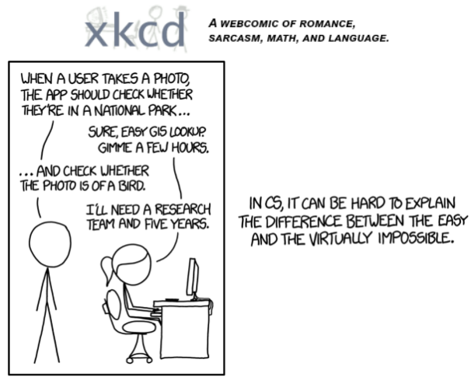

Image data
Xkcd, 2015
Machine Learning Methods for Biomedical Data (D012554)

Slide 2
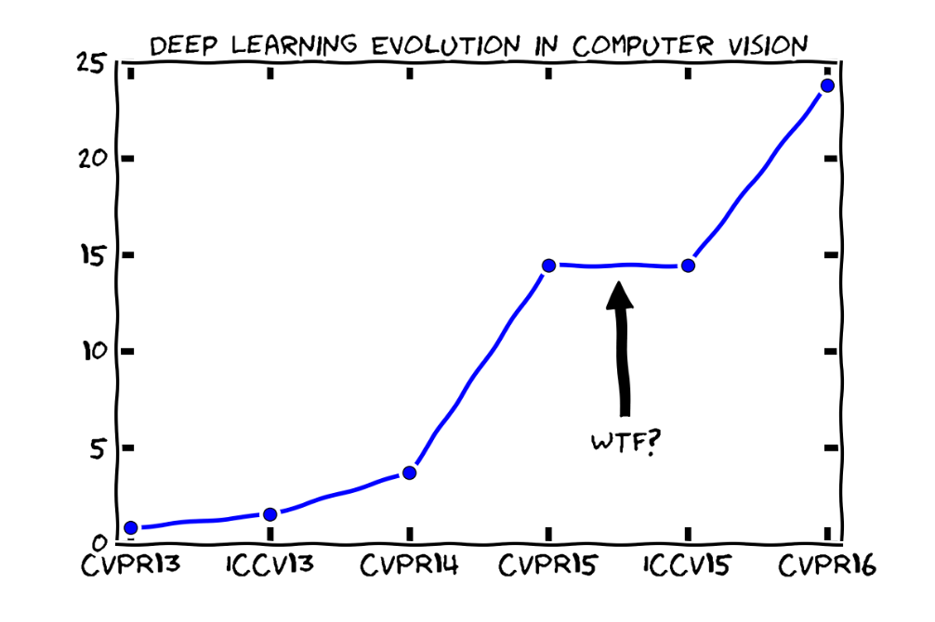
Image data
Xkcd
Machine Learning Methods for Biomedical Data (D012554)

Slide 3
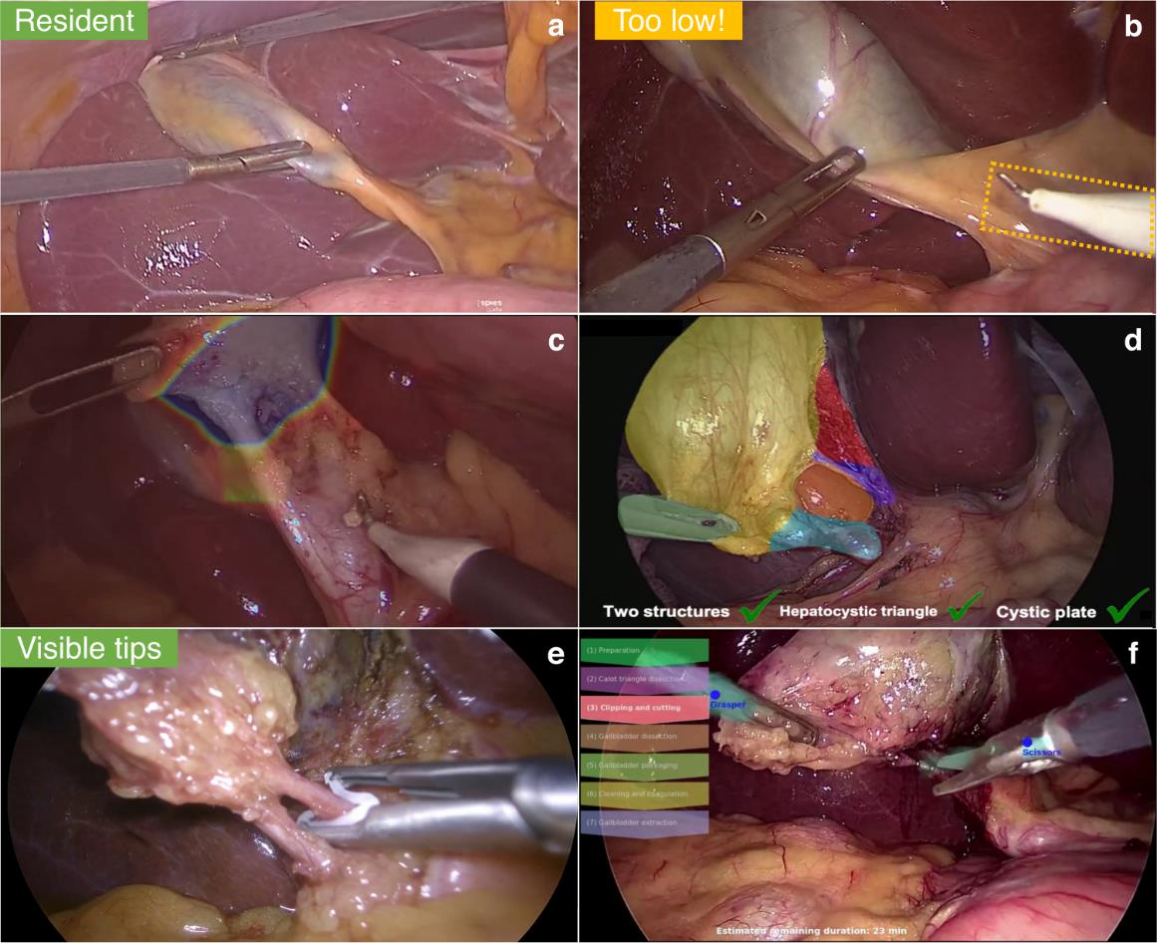
Computer vision
Derive meaningful information from digital images, videos and other visual inputs.
Take actions or make recommendations based on that information.
Mascagni, P., Alapatt, D., Sestini, L. et al. Computer vision in surgery: from potential to clinical value. npj Digit. Med. 5, 163 (2022)
Machine Learning Methods for Biomedical Data (D012554)

Slide 4
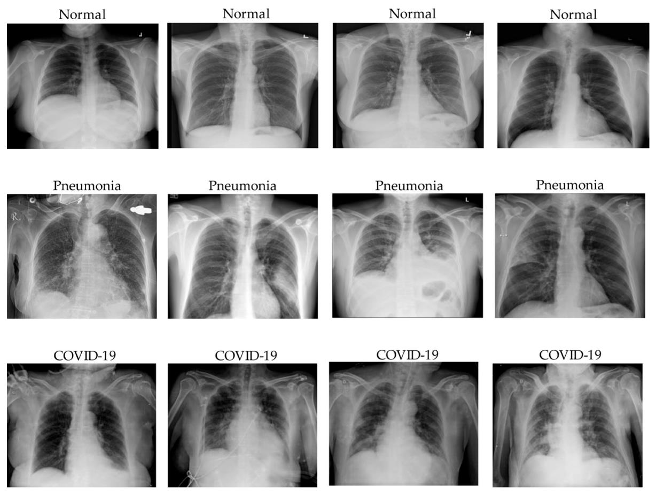
Computer vision
Classification: predict the class(es) an image or video belongs to.
Le Dinh, T, et al. COVID-19 Chest X-ray Classification and Severity Assessment Using Convolutional and Transformer Neural Networks. Appl. Sci. 2022, 12, 4861
Machine Learning Methods for Biomedical Data (D012554)

Slide 5
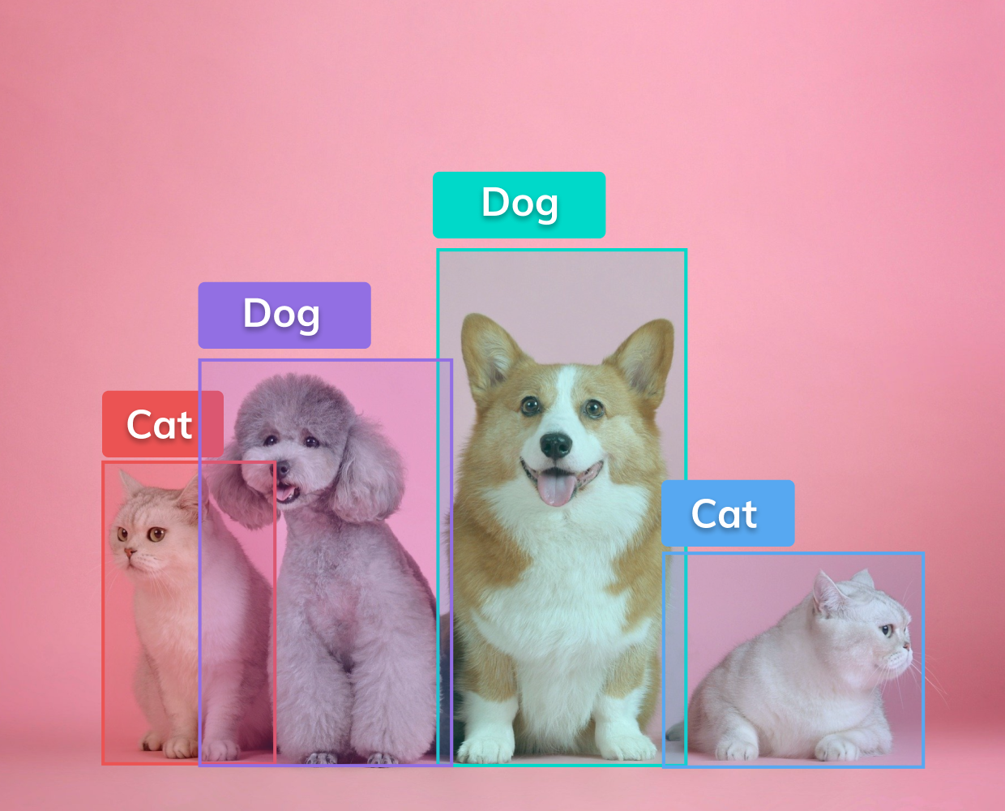
Computer vision
Classification: predict the class(es) an image or video belongs to.
Object detection: identify a certain class of image and then detect and tabulate their appearance in an image or video.
Machine Learning Methods for Biomedical Data (D012554)

Slide 6
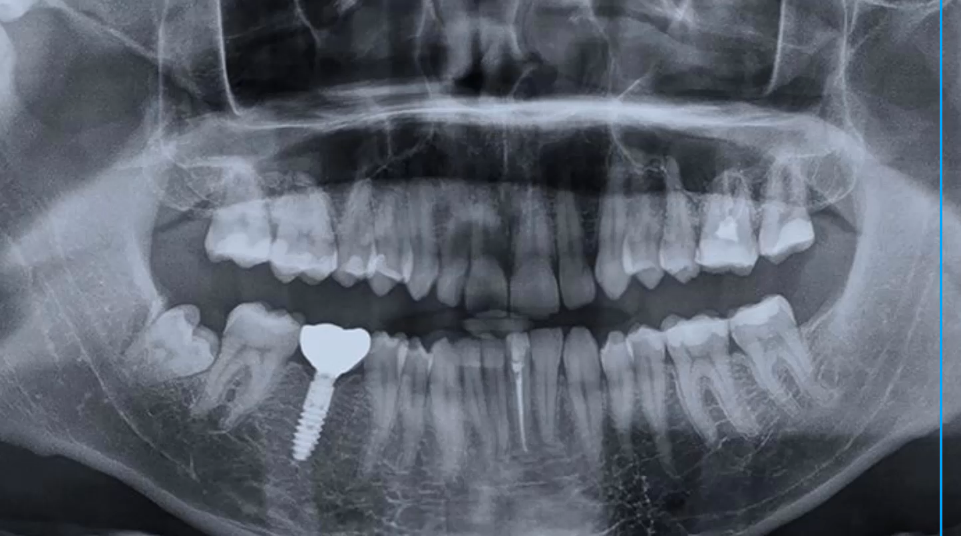
Computer vision
Classification: predict the class(es) an image or video belongs to.
Object detection: identify a certain class of image and then detect and tabulate their appearance in an image or video.
Machine Learning Methods for Biomedical Data (D012554)

Slide 7
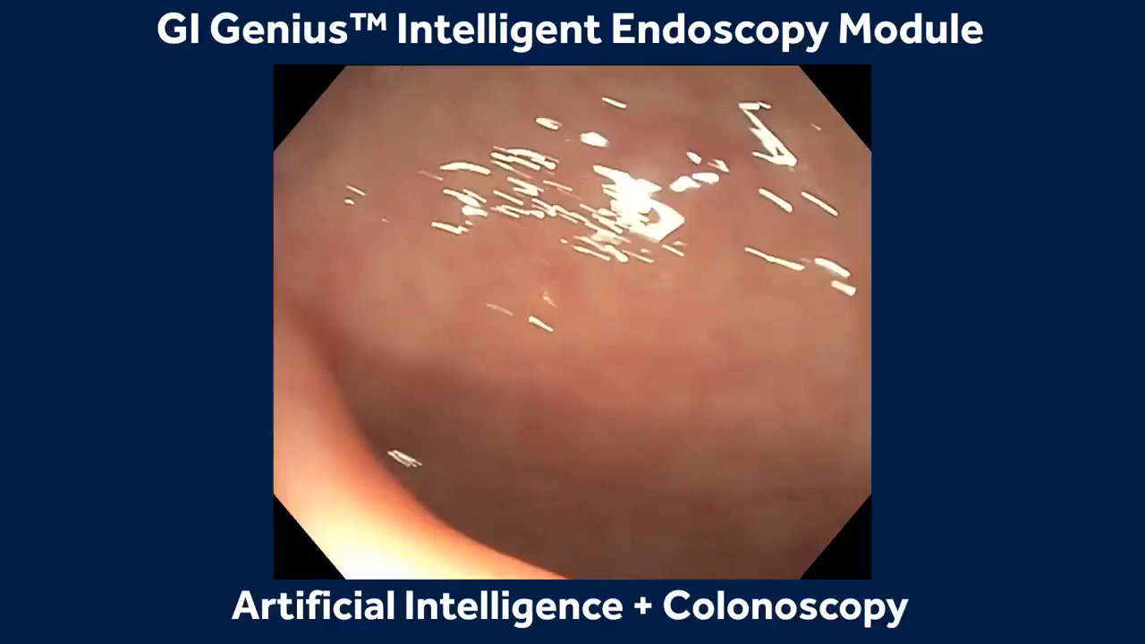
Computer vision
Classification: predict the class(es) an image or video belongs to.
Object detection: identify a certain class of image and then detect and tabulate their appearance in an image or video.
Machine Learning Methods for Biomedical Data (D012554)

Slide 8
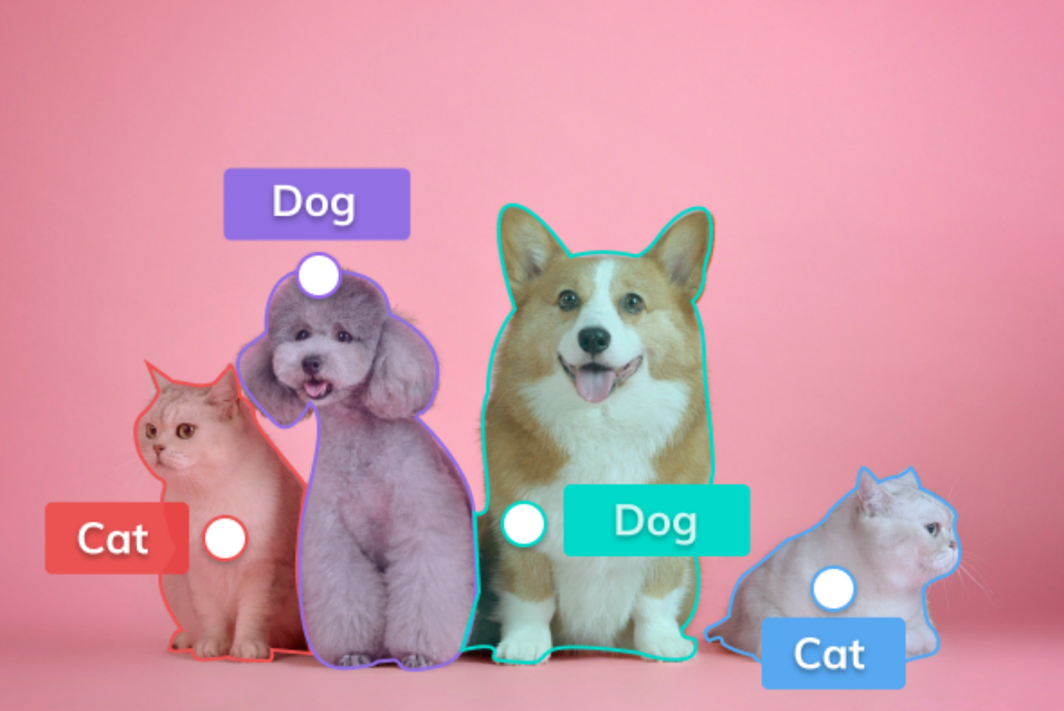
Computer vision
Classification: predict the class(es) an image or video belongs to.
Object detection: identify a certain class of image and then detect and tabulate their appearance in an image or video.
Segmentation: the process of partitioning a digital image into multiple image segments (regions).
Machine Learning Methods for Biomedical Data (D012554)

Slide 9
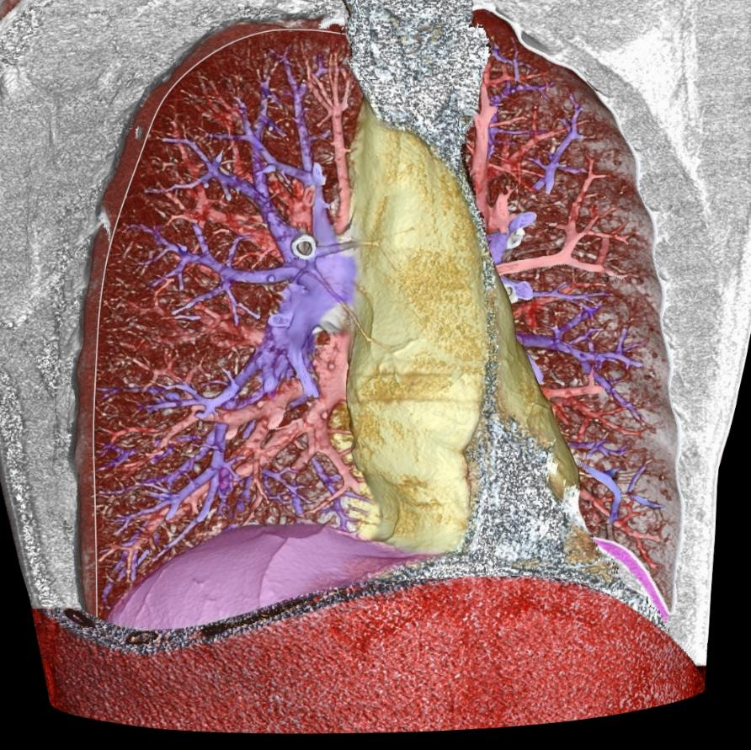
Computer vision
Classification: predict the class(es) an image or video belongs to.
Object detection: identify a certain class of image and then detect and tabulate their appearance in an image or video.
Segmentation: the process of partitioning a digital image into multiple image segments (regions).
pulmonary arteries: blue; pulmonary veins (and also the abdominal wall): red; the mediastinum: yellow; the diaphragm: violet
Machine Learning Methods for Biomedical Data (D012554)

Slide 10
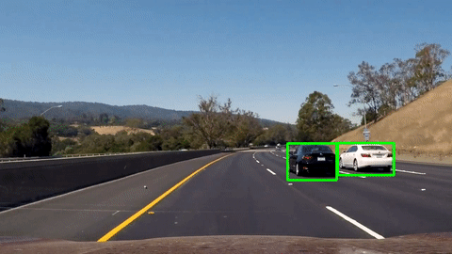
Computer vision
Classification: predict the class(es) an image or video belongs to.
Object detection: identify a certain class of image and then detect and tabulate their appearance in an image or video.
Segmentation: the process of partitioning a digital image into multiple image segments (regions).
Object tracking: follow the movement of an object in a video.
Machine Learning Methods for Biomedical Data (D012554)

Slide 11
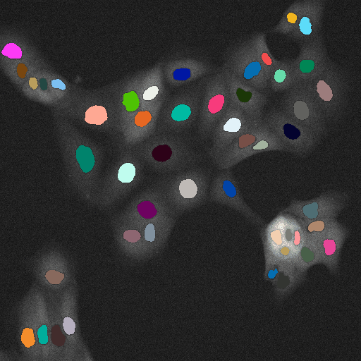
Computer vision
Classification: predict the class(es) an image or video belongs to.
Object detection: identify a certain class of image and then detect and tabulate their appearance in an image or video.
Segmentation: the process of partitioning a digital image into multiple image segments (regions).
Object tracking: follow the movement of an object in a video.
https://imaging.cs.msu.ru/en/research/cell-tracking
Machine Learning Methods for Biomedical Data (D012554)

Slide 12
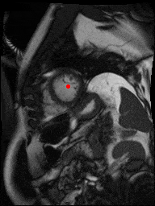
Computer vision
Classification: predict the class(es) an image or video belongs to.
Object detection: identify a certain class of image and then detect and tabulate their appearance in an image or video.
Segmentation: the process of partitioning a digital image into multiple image segments (regions).
Object tracking: follow the movement of an object in a video.
kaggle.com/second-annual-data-science-bowl (2015)
Machine Learning Methods for Biomedical Data (D012554)

Slide 13
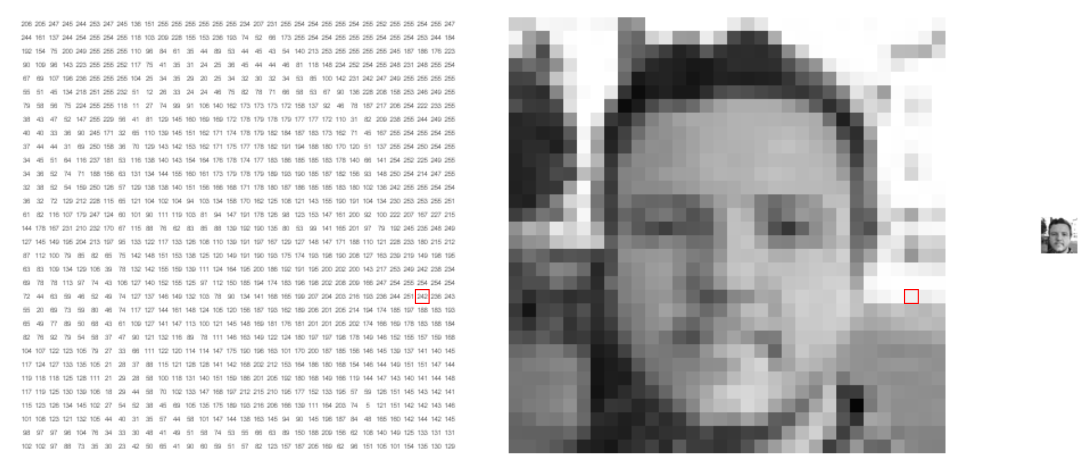
What computers see
https://setosa.io/ev/image-kernels/
Machine Learning Methods for Biomedical Data (D012554)
Notes:
Shifts
Scale
anngles
Shadows

Slide 14
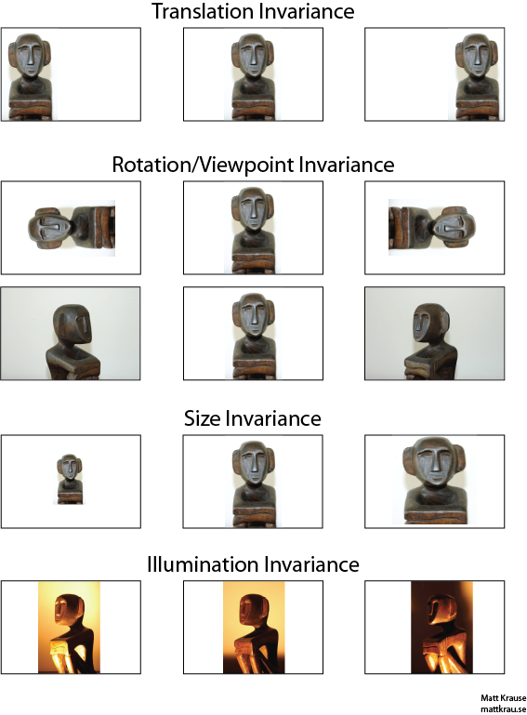
Invariances
Invariance means that we can recognize an object as an object, even when its appearance varies in some way.
Machine Learning Methods for Biomedical Data (D012554)
Notes:
Shifts
Scale
anngles
Shadows

Slide 15
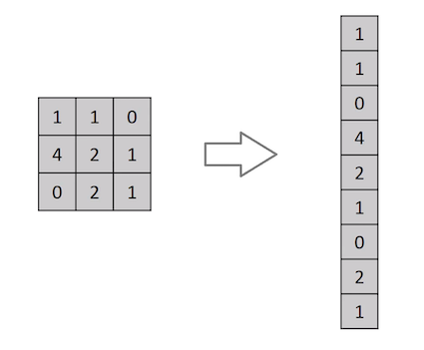
Flatten
We could just represent each pixel as a feature.
This would mean that we flatten the 2D matrix to a 1D feature vector.
The learning algorithm then needs to learn the 2D spatial correlations from the 1D representation.
And what with the invariances?
Machine Learning Methods for Biomedical Data (D012554)
Notes:
Shifts
Scale
anngles
Shadows

Slide 16
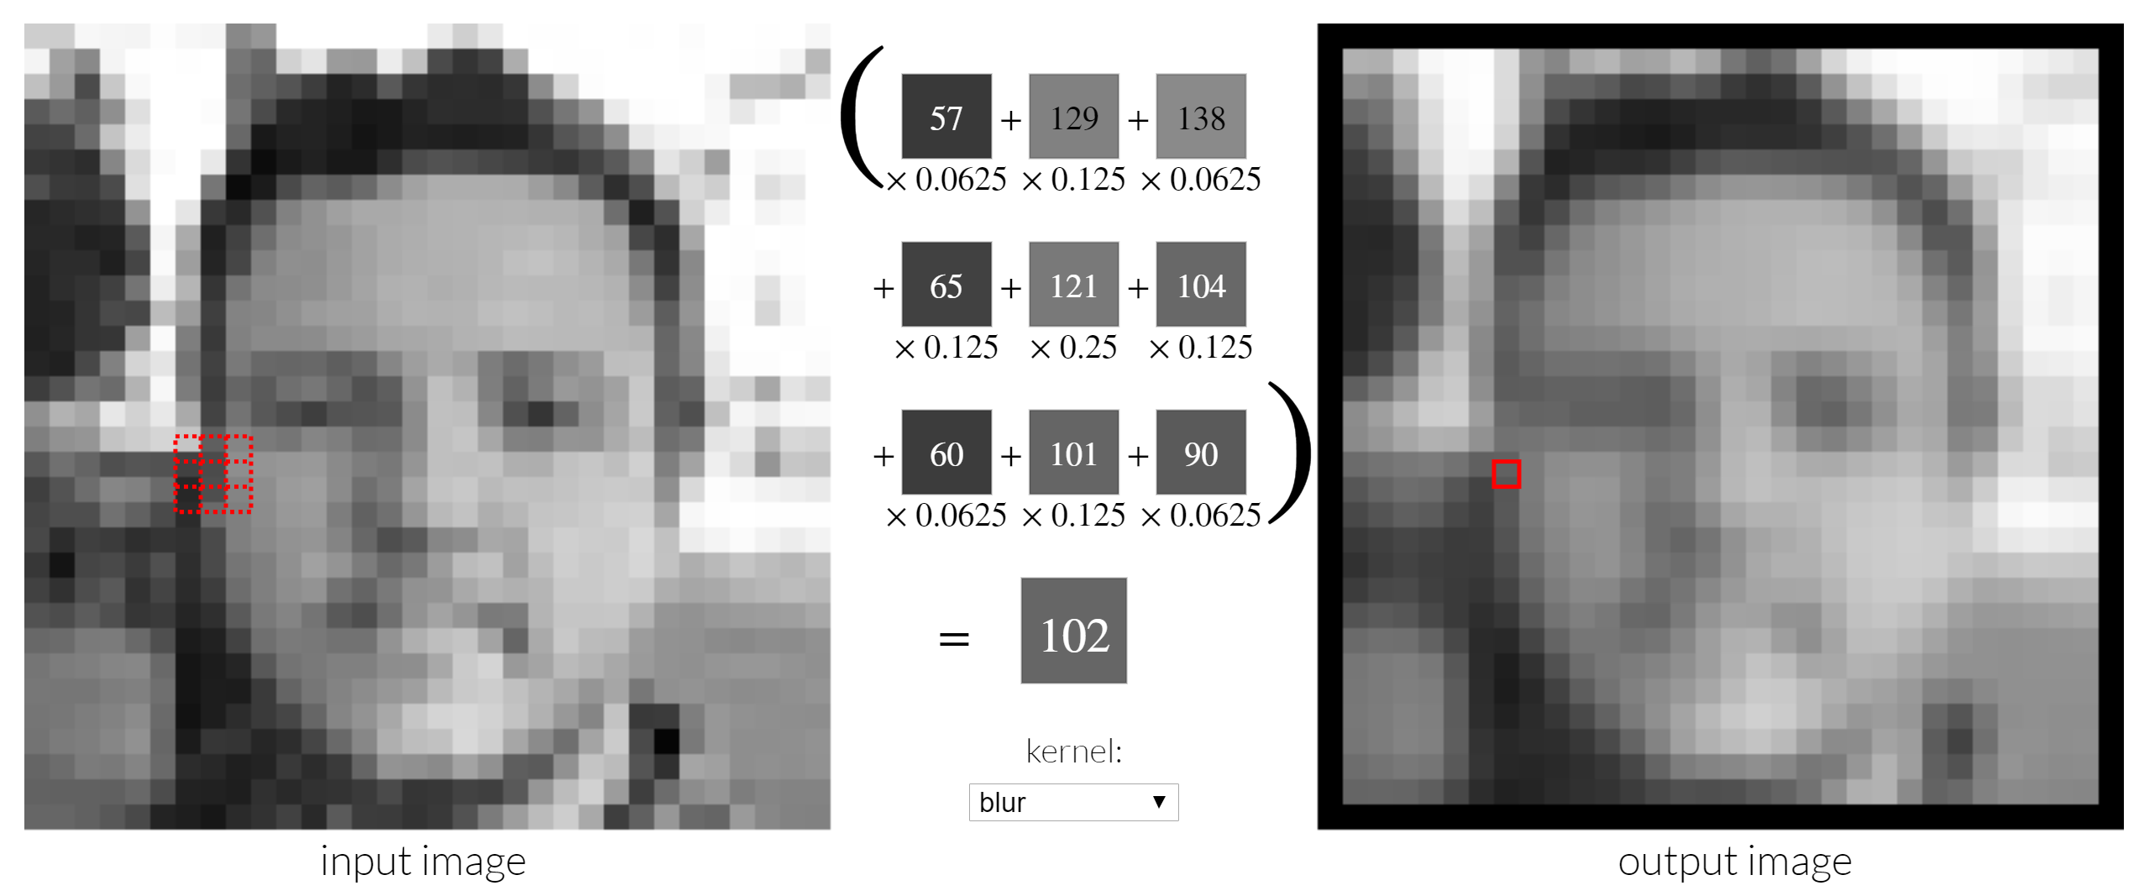
Convolutional filter
Convolutional filters are small matrices that “slide” over an image.
They provides a measure for how close a patch or a region in the image resembles a feature.
Machine Learning Methods for Biomedical Data (D012554)
Notes:
Shifts
Scale
anngles
Shadows

Slide 17

Convolutional neural networks (CNN)
A convolutional neural network (CNN) module stacks modules that consist of
- feature maps (or channels) that each learn a relevant convolutional filter with specific dimensions, and
- a pooling layer that allows for the location invariance of the learned features.
Machine Learning Methods for Biomedical Data (D012554)
Notes:
Shifts
Scale
anngles
Shadows

Slide 18
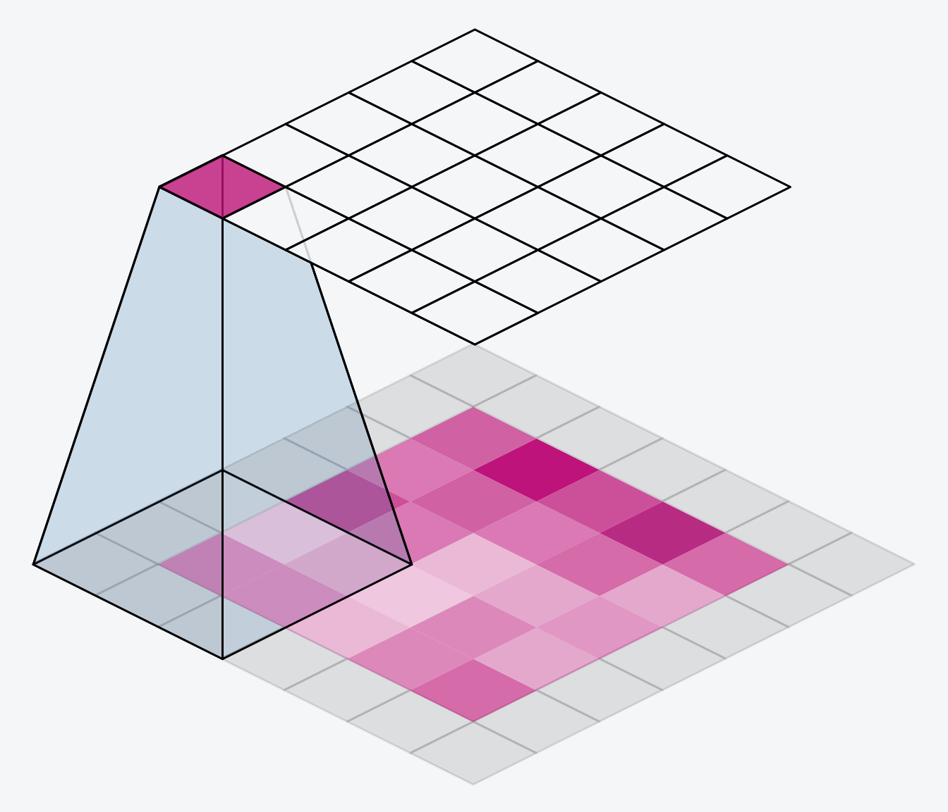
Feature map
Each neuron looks at a different (overlapping) part in the image and performs a convolution.
The convolution is defined by the modelparameters that are learned from the data.
So, in each feature maps, the modelparameters for each neuron have the same value, i.e. they are shared. The only difference is in what part of the image the neuron looks at.
Machine Learning Methods for Biomedical Data (D012554)
Notes:
Shifts
Scale
anngles
Shadows

Slide 19
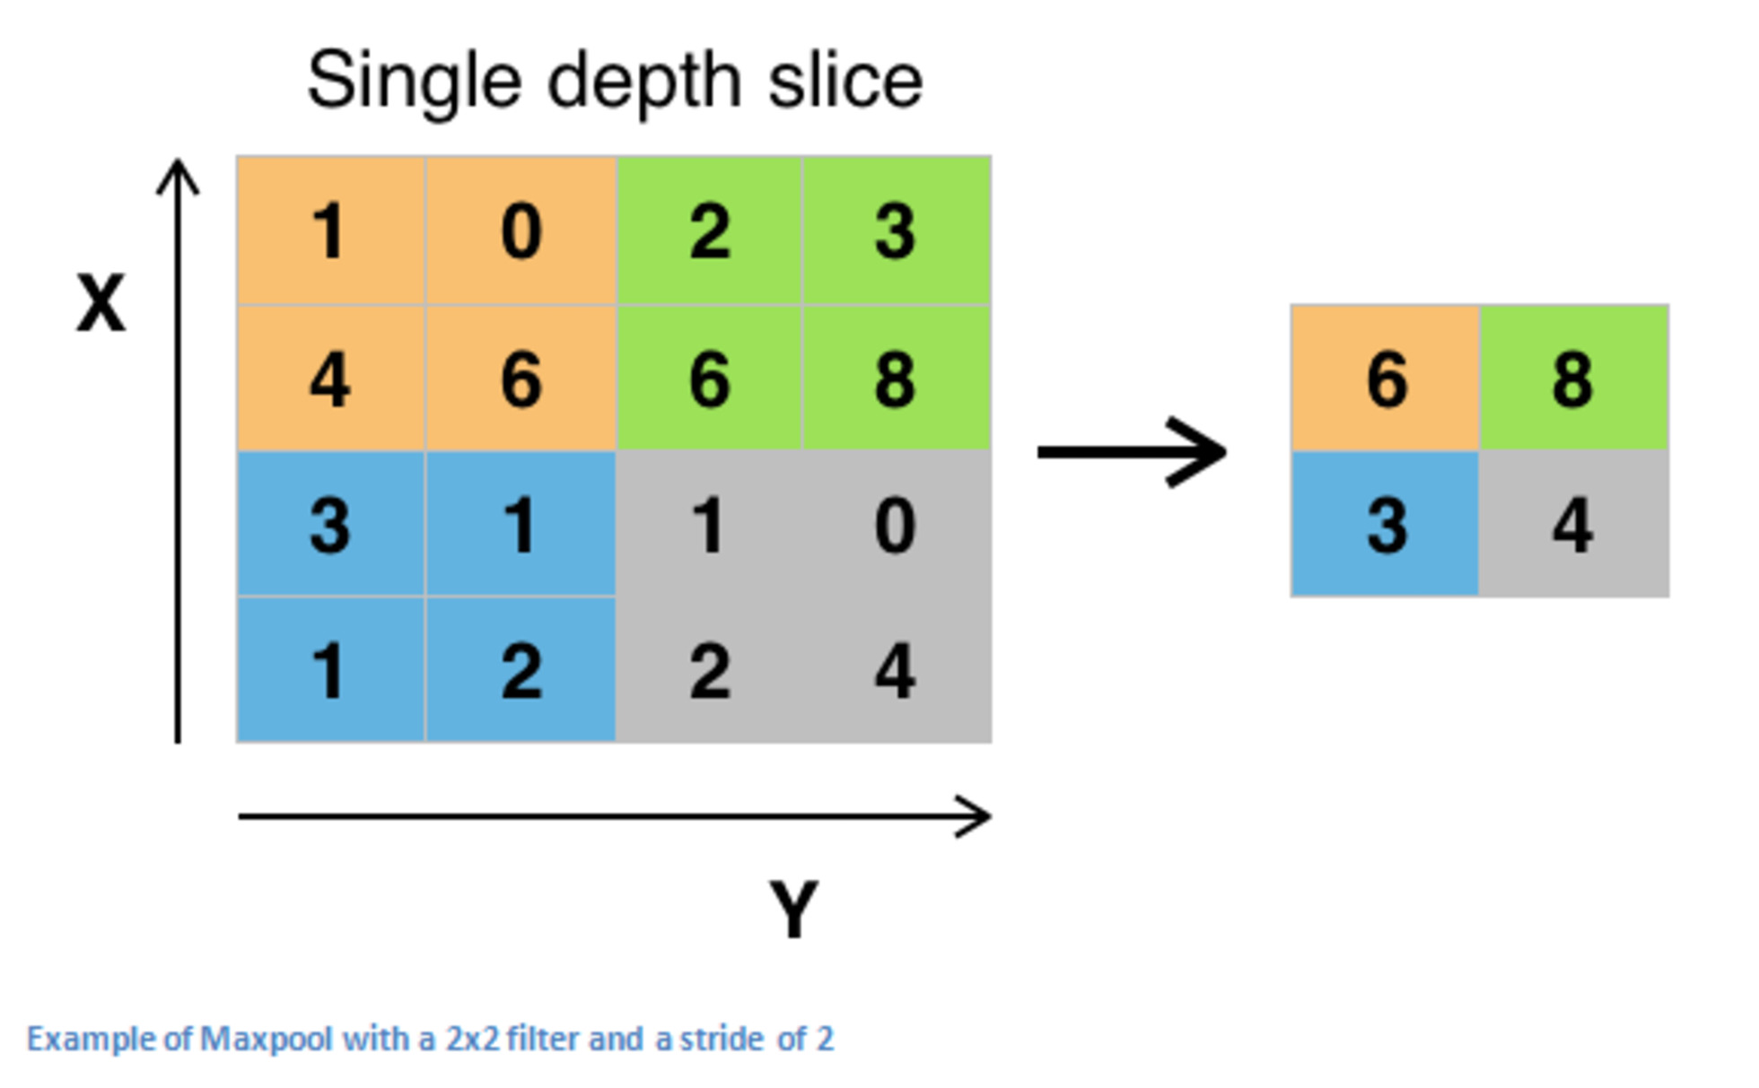
Pooling
Maximum pooling, or max pooling, is a pooling operation that calculates the maximum, or largest, value in each patch of each feature map.
Machine Learning Methods for Biomedical Data (D012554)
Notes:
Shifts
Scale
anngles
Shadows

Slide 20
Invariances: data augmentation
CNNs are
translation invariant,
scale invariant to some degree (learned from data, not in filters),
not rotation invariant (learned from data),
not illumination invariant (learned from data).
We can generate artificial data, by rotating, scaling, illuminating training images. A process called data augmentation. This is a form of model regularization.
Machine Learning Methods for Biomedical Data (D012554)
Notes:
Shifts
Scale
anngles
Shadows

Slide 21

CNN
Machine Learning Methods for Biomedical Data (D012554)

Slide 22


CNN: channels
Machine Learning Methods for Biomedical Data (D012554)
Notes:
Shifts
Scale
anngles
Shadows

Slide 23

Neural network
mnist_pytorch.ipynb
Machine Learning Methods for Biomedical Data (D012554)

Slide 24
ImageNet
ImageNet is a large-scale visual database designed for use in visual object recognition research, containing millions of labeled images across thousands of categories.
It was introduced by Fei-Fei Li and her team in 2009 and played a crucial role in advancing deep learning, particularly in convolutional neural networks (CNNs).
The ImageNet Large Scale Visual Recognition Challenge (ILSVRC), held annually from 2010 to 2017, drove major breakthroughs in AI and computer vision, with models like AlexNet, VGG, ResNet, and EfficientNet achieving state-of-the-art performance.
Despite its influence, ImageNet has limitations, including dataset bias, ethical concerns related to labeling, and challenges in real-world generalization beyond the controlled dataset.
Machine Learning Methods for Biomedical Data (D012554)
Notes:
Shifts
Scale
anngles
Shadows

Slide 25
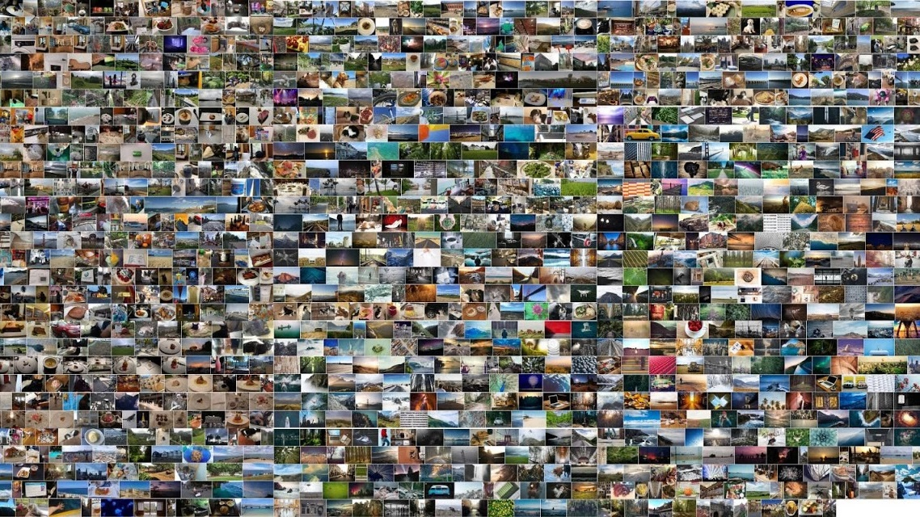
Data is everything: ImageNet
J. Deng et al., "ImageNet: A large-scale hierarchical image database," 2009 IEEE Conference on Computer Vision and Pattern Recognition
Machine Learning Methods for Biomedical Data (D012554)
Notes:
14.197.122 images
21.841 subcategories
27 high-level categories

Slide 26
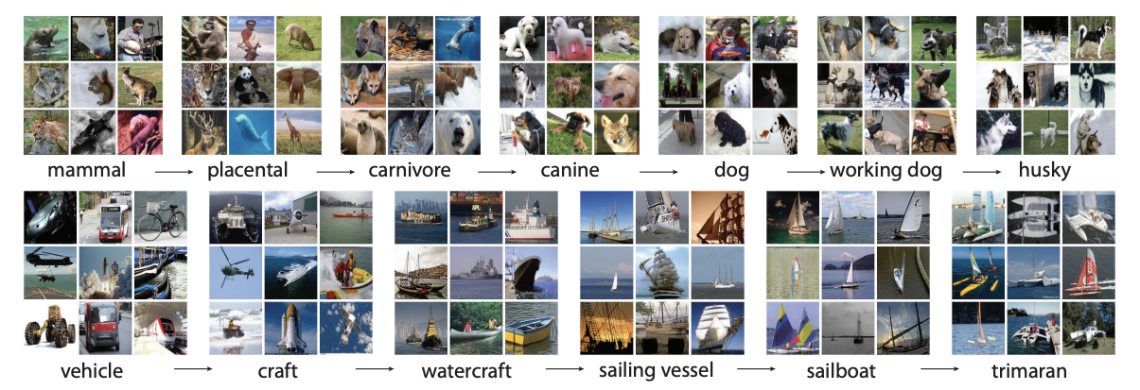
Data is everything: ImageNet
Machine Learning Methods for Biomedical Data (D012554)
Notes:
Shifts
Scale
anngles
Shadows

Slide 27
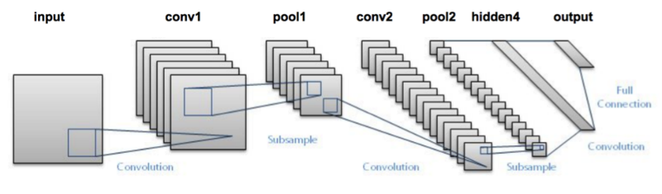
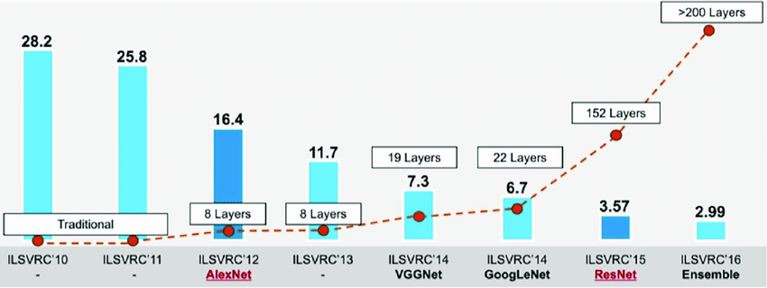
ImageNet: computer vision is solved
LeNet-5 (1998)
ImageNet Large Scale Visual Recognition Challenge: https://www.image-net.org/challenges/LSVRC/
Machine Learning Methods for Biomedical Data (D012554)
Notes:
LeNet-5, a pioneering 7-level convolutional network by LeCun et al in 1998, that classifies digits, was applied by several banks to recognise hand-written numbers on checks (cheques) digitized in 32x32 pixel greyscale inputimages. The ability to process higher resolution images requires larger and more convolutional layers, so this technique is constrained by the availability of computing resources.

Slide 28
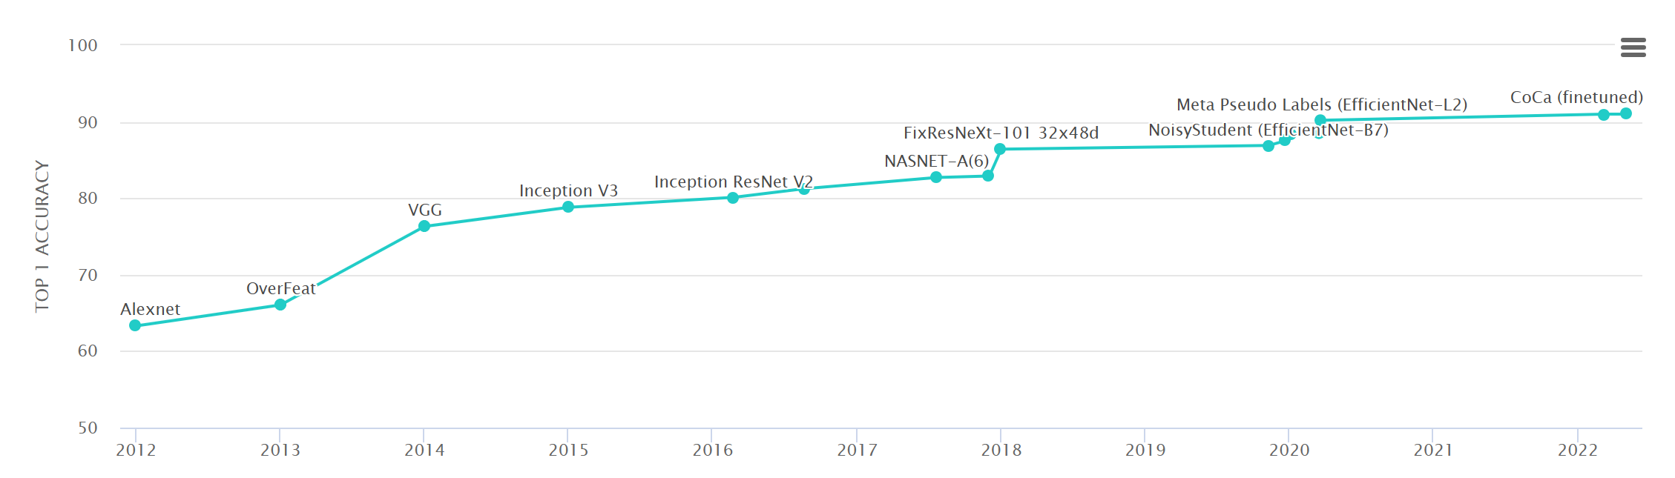
ImageNet: computer vision is solved
https://paperswithcode.com/sota/image-classification-on-imagenet
Machine Learning Methods for Biomedical Data (D012554)

Slide 29
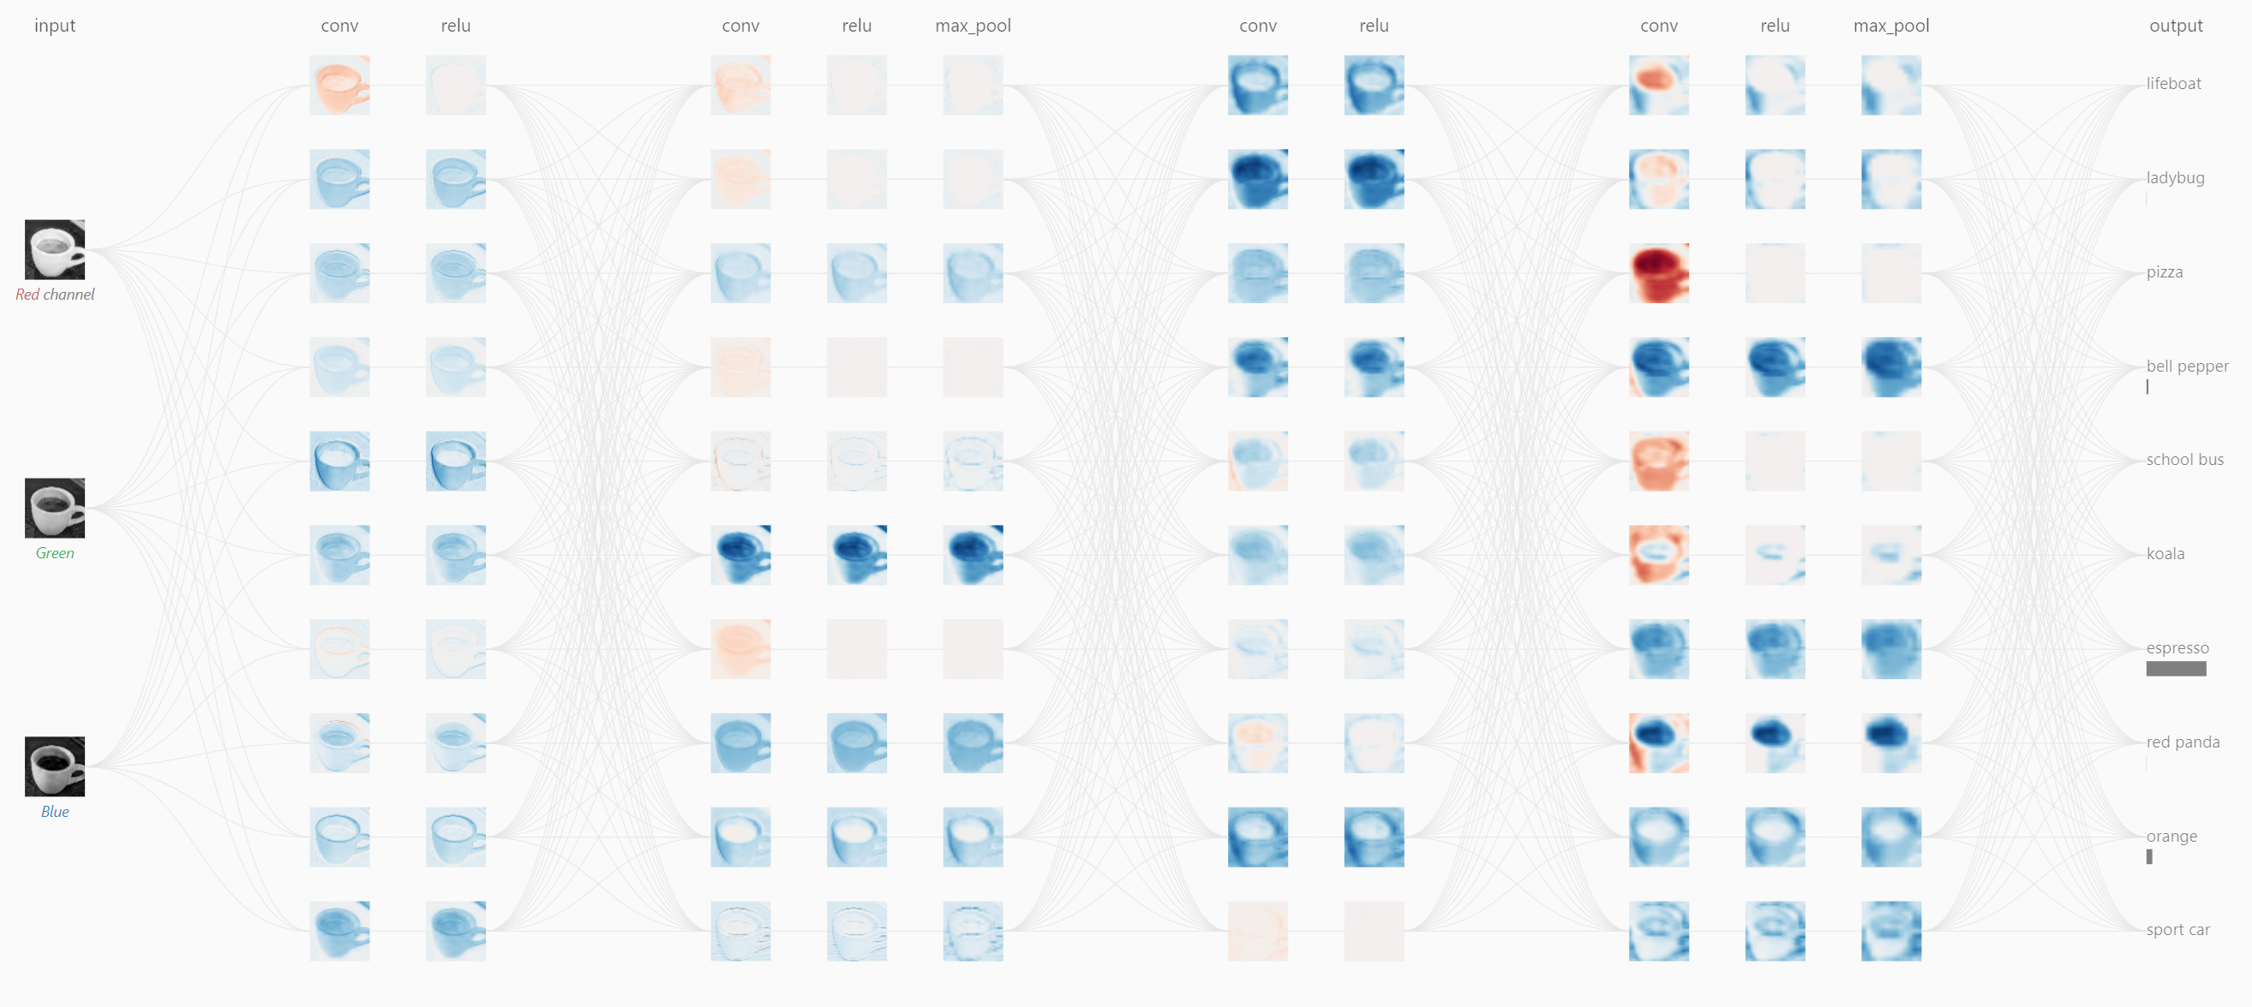
What computers see
https://poloclub.github.io/cnn-explainer/
Machine Learning Methods for Biomedical Data (D012554)
Notes:
Shifts
Scale
anngles
Shadows

Slide 30
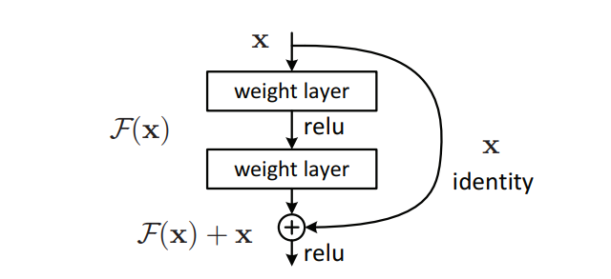
ResNet (Residual Network)
ResNet introduces skip connections, allowing gradients to bypass certain layers, solving the vanishing gradient problem and enabling the training of very deep networks.
He, K., Zhang, X., Ren, S., & Sun, J. (2016). Deep Residual Learning for Image Recognition. CVPR, 770-778.
Machine Learning Methods for Biomedical Data (D012554)
Notes:
Shifts
Scale
anngles
Shadows

Slide 31
ResNet (Residual Network)
ResNet introduces skip connections, allowing gradients to bypass certain layers, solving the vanishing gradient problem and enabling the training of very deep networks.
Instead of learning the full transformation, ResNet learns the residual (difference) between input and output, making optimization easier and improving convergence.
ResNet enables training of networks with hundreds or even thousands of layers, significantly improving performance in image recognition tasks without degradation.
He, K., Zhang, X., Ren, S., & Sun, J. (2016). Deep Residual Learning for Image Recognition. CVPR, 770-778.
Machine Learning Methods for Biomedical Data (D012554)
Notes:
Shifts
Scale
anngles
Shadows

Slide 32
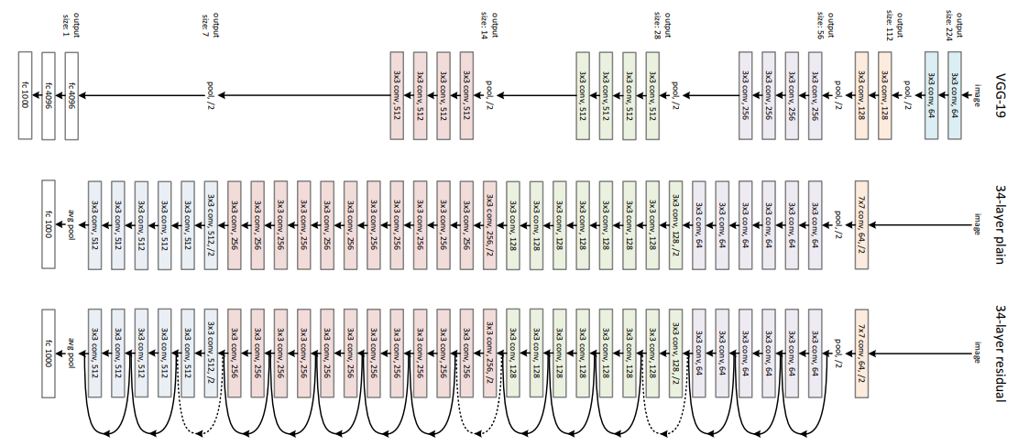
ResNet (Residual Network)
He, K., Zhang, X., Ren, S., & Sun, J. (2016). Deep Residual Learning for Image Recognition. CVPR, 770-778.
Machine Learning Methods for Biomedical Data (D012554)
Notes:
Shifts
Scale
anngles
Shadows

Slide 33
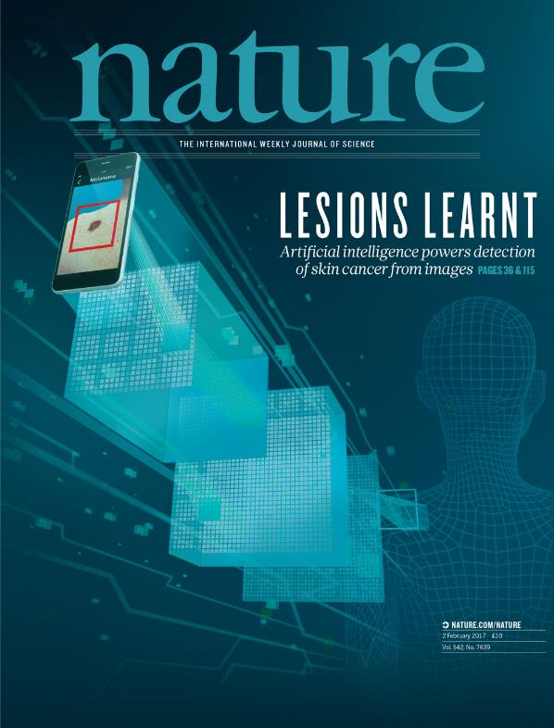
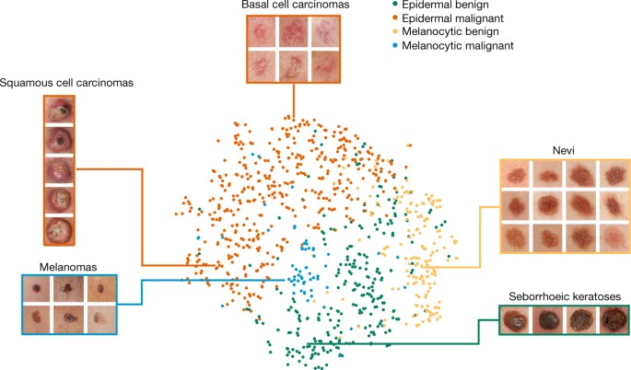
Remember this?
Thrun et al., Dermatologist-level classification of skin cancer with deep neural networks, Nature (2017)
Machine Learning Methods for Biomedical Data (D012554)

Slide 34
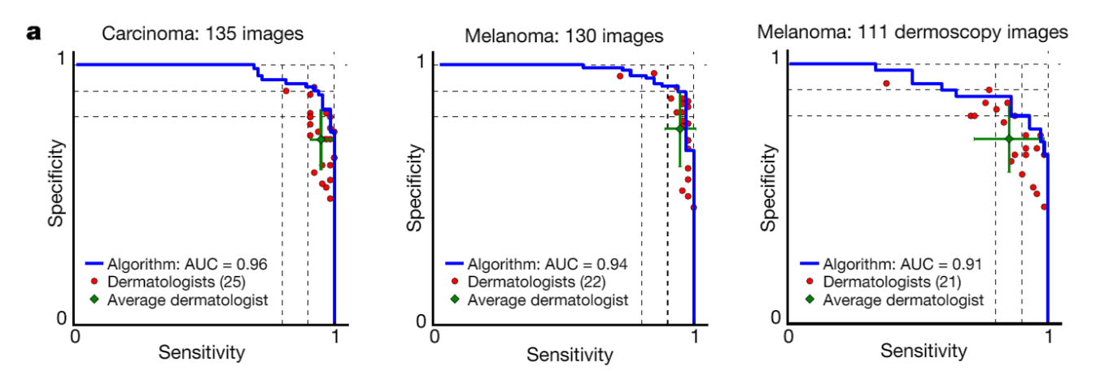
keratinocyte carcinomas: 65
benign seborrheic keratoses: 75
malignant melanomas: 33
benign nevi: 97
malignant melanomas: 71
benign nevi: 40
Thrun et al., Dermatologist-level classification of skin cancer with deep neural networks, Nature (2017)
Machine Learning Methods for Biomedical Data (D012554)

